Slide 1
Virtual Analog Effects Leedy, Ben Jain, Nishant Pingali, Govinda March 26th 2013

Slide 2
Introduction / Contents
Digitization of music production equipment
“Warm”, “Lo-Fi” sounding
Non-Linear and produces distortion
Analog-circuit analysis, Electro-mechanical device analysis
Virtual Analog Filters
Circuit-based valve emulation
Tape based echo simulation
Antiquing
Electromechanical effects

Slide 3
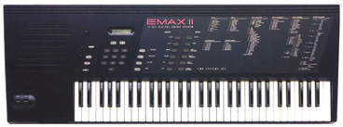
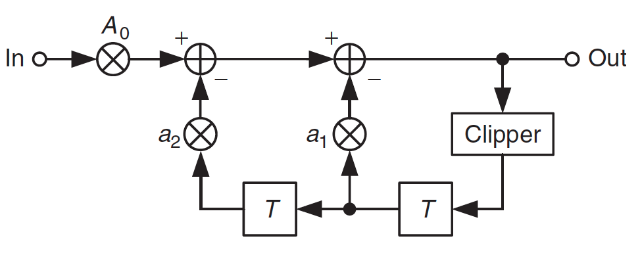
Virtual Analog Filters
Nonlinear Resonator
Harmonic Distortion, Compression at high signal level
Changing resonant frequency
Saturating nonlinearity in feedback path of 2nd order all-pole filter
E-mu EMAX II

Slide 4
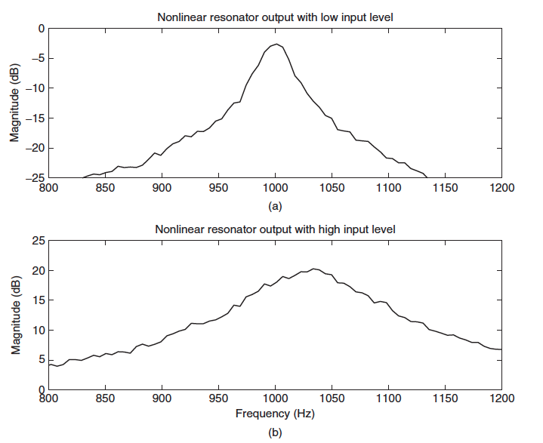
Nonlinear Resonator
Resonant Frequency: 1KHz
Bandwidth: 20Hz
Fs = 44.1KHz
Peak: -3dB @ 1Khz
Saturation Limit of clipper: 1
For signal at about 40 times saturation limit:
Resonant Frequency: 1.04KHz
Bandwidth: 70Hz
Peak: ~20dB @ 1.04Khz

Slide 5
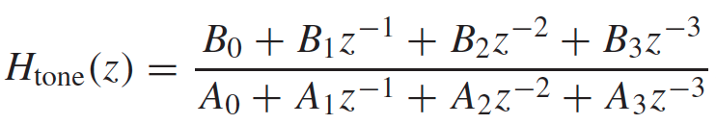
Tone Stack
3 channel eq in amps
3rd order transfer function:
C1,C2,C3 => Capacitor Values; R1,R2,R3 => Resistor Values
Calculate Analog Transfer Function Coefficients using RC values
Calculate Digital Transfer Coefficients using bilinear transofrmation
Problem: Models only basic circuit parameters (RC values).
Ex: No modeling of type of capacitors/resistors used

Slide 6
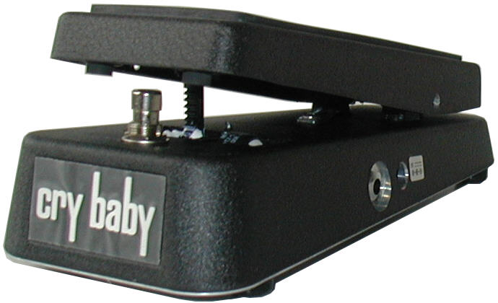
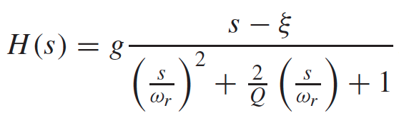
Cry Baby Wah
Wah: Sweep single resonant frequency through the spectrum, typically 2nd order
Transfer Function (s-plane):
g: gain
ω_{r}: pole resonance frequency
ξ: zero @ ~DC, ∞
Q, ω_{r,} g: vary with pedal position, θ
Algorithm: Higher amplitude at lower frequency
Better modeling with adaptive ‘g’; preserves ‘loudness’

Slide 7
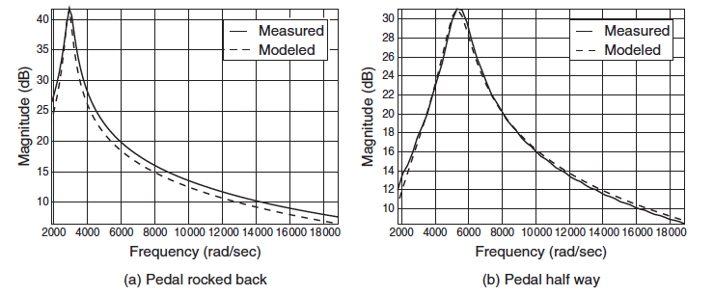
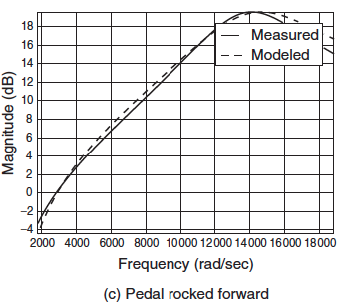
Cry Baby Wah
Algorithm:
Higher amplitude at lower frequencies
Better modeling with adaptive ‘g’; ‘preserves loudness’

Slide 8
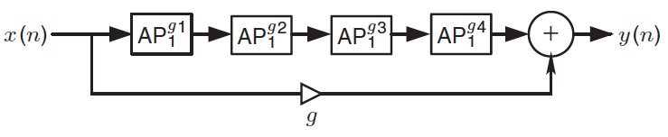


Phaser
Sweeping “notches” across spectrum
Notch created by summing input signal with variably phase-shifted version of input.
Phase-shifting: 4 cascaded 1st / 2nd order all-pass filters
Each analog all-pass: Bilinear Transformation:

Slide 9
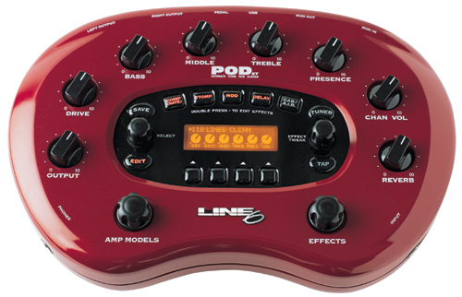
Circuit-based Valve Emulation
Digital emulation of valve/vacuum tube amplifiers
Static Wave-shapers
Custom Nonlinear Filters
Circuit Simulation
Dynamic Nonlinearities and Impedance Coupling
Valve component: memoryless device, static nonlinear function
Reactive components: dynamic nonlinearities
Shape of nonlinearity: dependent on input signal and state of circuit
2-directional impedance coupling: additional signal dependent bias when connected to reactive load (loudspeaker) – ‘loading’
Digital/virtual model using uni-directional path: only linear filtering
Kirchoff’s laws and energy conservation used to obtain difference equation

Slide 10
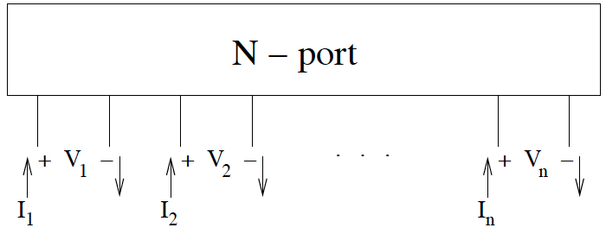
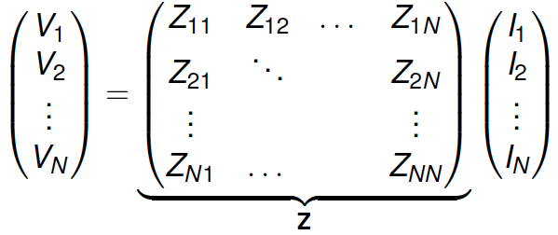
Wave Digital Filters
Direct one-to-one mapping from physical component to filter state variable
Modular, Computationally “Lighter”
All signals, states represented as ‘wave variables’
Classical Network Theory (N-port analysis):
Impedance Matrix:

Slide 11
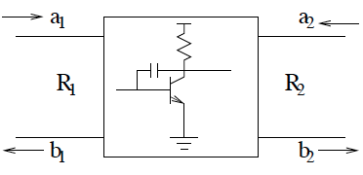



Wave Digital Filters
A = V + RI // Incident Wave
B = V – RI // Reflected Wave
Scattering Matrix
Wave reflectance between 2 impedances

Slide 12
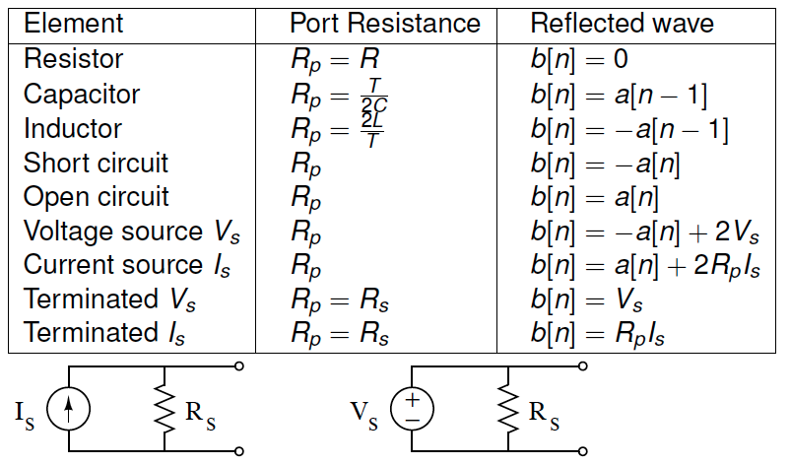
Wave Digital Filters

Slide 13
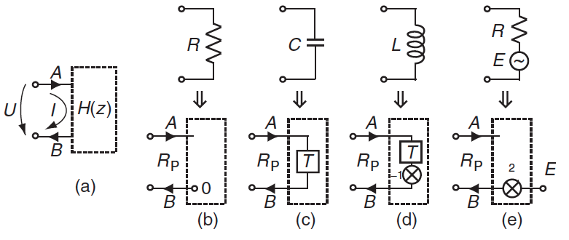
Wave Digital Filters
One-port elements:
WDF components connected through ports
‘Port Resistance’(Rp) – impedance coupling

Slide 14

Wave Digital Filters
WDF Circuit components connected by Adaptors
Adaptor: directs signal routing
Typically, 3-port adaptors used
Two types:
Series
Parallel
Bn (outgoing wave at n=1,2,3). G->1/R

Slide 15
Diode Circuit Model
Wave Digital Filter Implementation

Slide 16
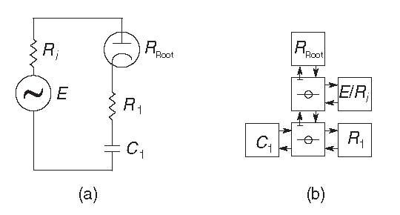
Circuit
Simplified representation of actual amplifier
Tube diode acts as nonlinear resistor.

Slide 17
WDF Classes
These classes implement the various components of the circuit.
Most important are the circuit element models: C (cap), R (res), V (voltage).
Other classes define the port direction (up/down).

Slide 18
WDFDiodeExample.m
Main effect function
Implements circuit by using the various element objects
Nonlinear resistor (tube diode) implemented manually (not as an R object)

Slide 19
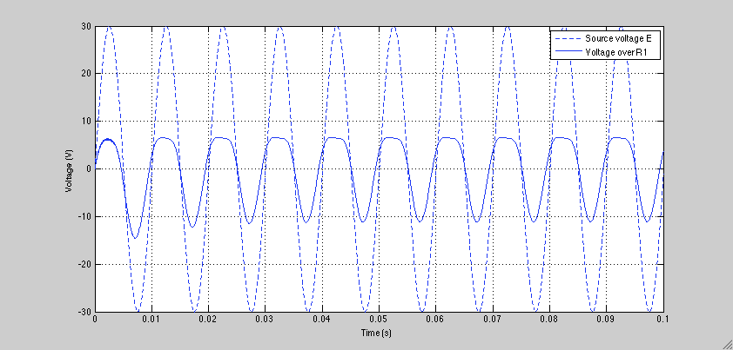

Result
Output is quite similar to input.
Output is quieter than input, with slight distortion. (dotted line represents input)
Input
Output

Slide 21
Tape-Based Echo Simulation
Two different machines:
Maestro Echoplex EP-4
Roland RE-201 Space Echo

Slide 22
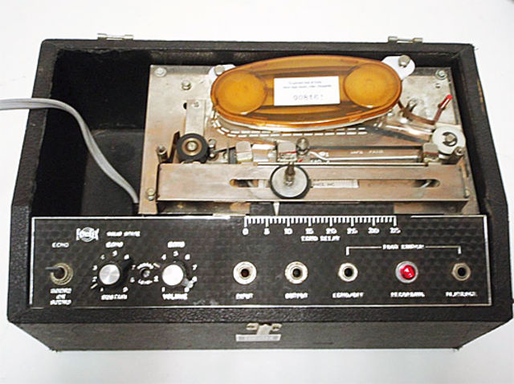
Echoplex EP-4

Slide 23
Echoplex EP-4
Record Head
Playback Head
Tape
Tape Motion
Distance between Record Head and Playback Head defines the delay time.

Slide 24
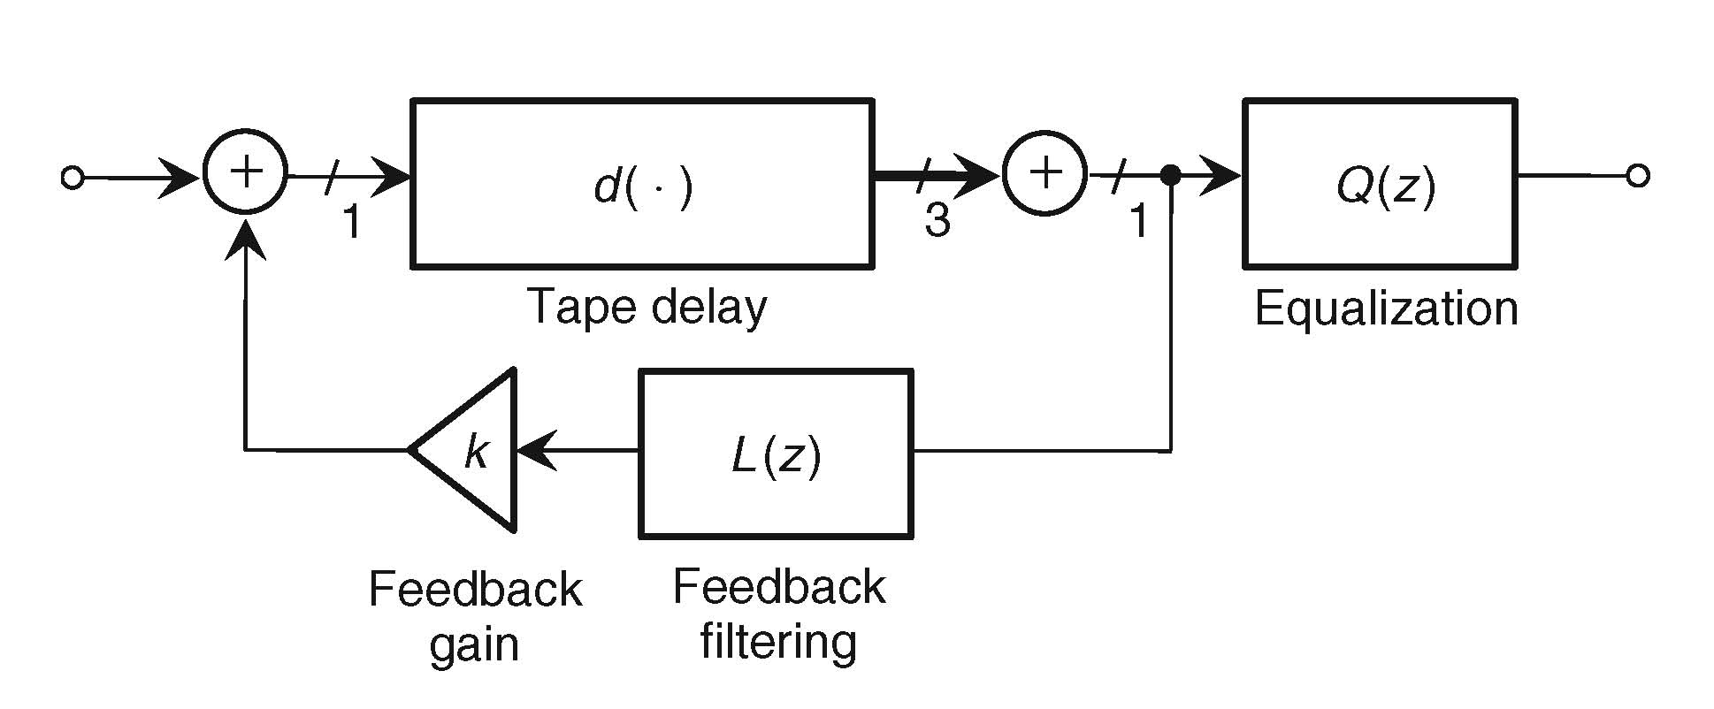
Signal Flow

Slide 25
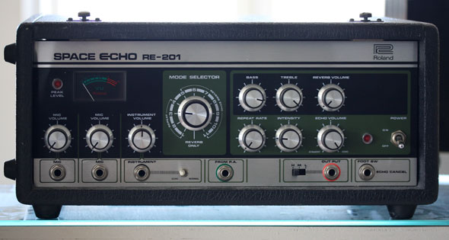
RE-201 Space Echo

Slide 26
RE-201 Space Echo
Uses similar principle as the Echoplex.
Has 3 playback heads instead of one for multiple echo mixes.
Changes the speed of the tape to vary delay time.
Sample

Slide 27
Modeling
Factors to consider:
Time delay is not constant due to fluctuating tape speeds.
Tape is spliced into a loop; this splice slows the tape periodically as it passes through the capstan and pinch wheel.

Slide 28
Algorithm
Delay trajectory is calculated from the velocity function (estimated using the energy in the pinch wheel and capstan as parameters). This is the mean delay.
Two other delays are mixed with the mean delay:
Quasi-periodic processes representing the observed capstan and pinch wheel harmonics.
Stochastic low-frequency drift.

Slide 29
Algorithm
This sum is then averaged with a running mean filter with filter length equal to time delay.
Lagrange Interpolation is used to create the delay

Slide 30
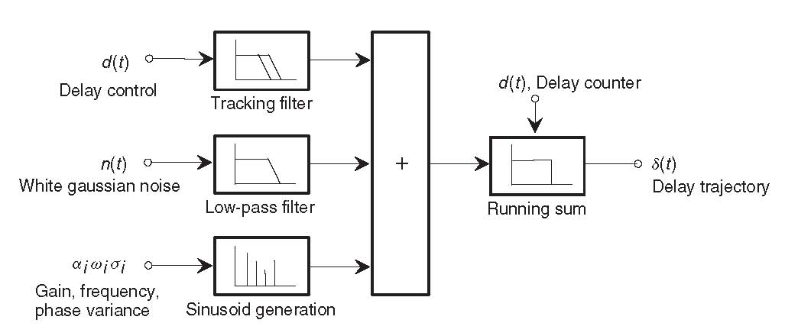
Signal Model

Slide 31
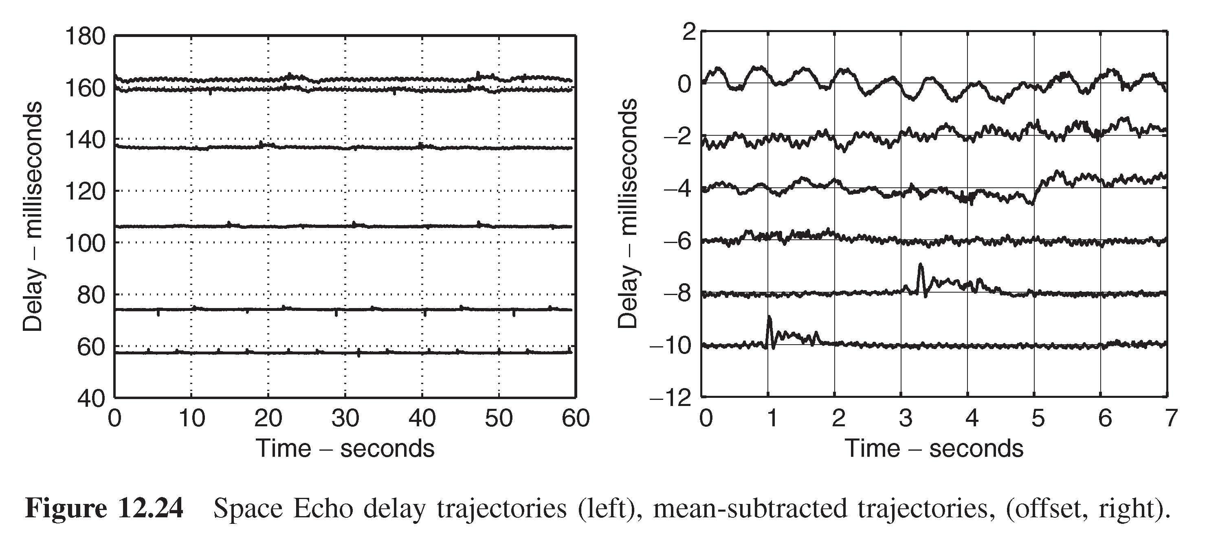
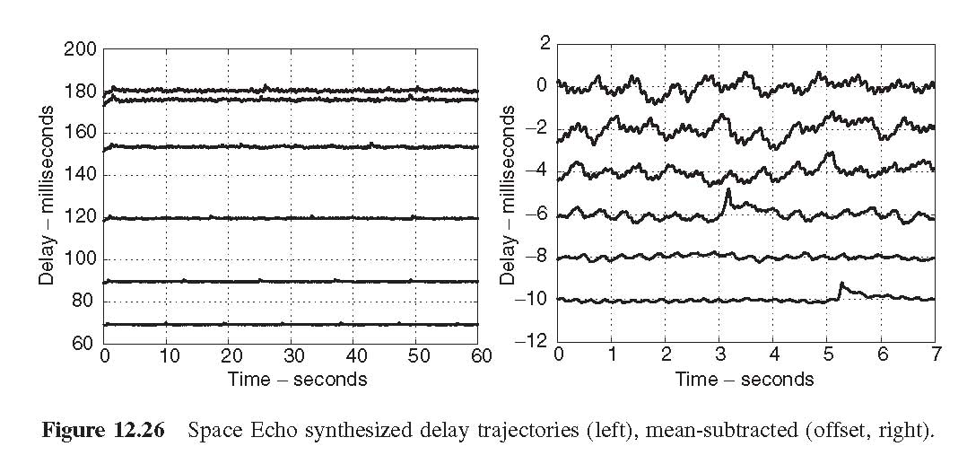
Delay Trajectories

Slide 32
Other Factors
Effect of Hysteresis on the magnetic tape
Equalization

Slide 34
Telephone Line Effect
Simulates the effect of an audio signal produced by a phone, especially an older telephone.

Slide 35
Algorithm
FIR Bandpass filter to create a very low bandwidth signal.
12th order Chebyshev with cut-off frequencies of 234 and 4300 Hz, stop-band rejection of -40 dB.
Nonlinear filter to simulate carbon microphone nonlinearity
Add noise.

Slide 36
phonefx.m
Function to implement the telephone line filter
Input parameters:
alpha: controls how great the nonlinear effect is (>=0)
noise: controls amplitude of white, zero-mean, Gaussian noise (values near 0.01 typically)
x: input signal
Input
Output

Slide 38
Electromechanical Effects
Mechanical elements in conjunction with analog electronics
Physical modeling of the mechanical component's acoustics
Eg., Leslie speaker, tape delays
Electromechanical artificial reverberation
Plate
Spring
Complex response due to spatially distributed acoustic characteristics
Modes of vibration
Finite propagation time for acoustic waves
DISTRIBUTED MODELLING

Slide 39

Wave Equation
3-D wave equation :
p(x,y,z,t) : acoustic pressure
c : speed of sound (343 m/s@ room temp)
∇ : Leplace operator

Slide 40
Wave equation solution
Solution to 1-D wave equation
ω : angular frequency (2π/f)
β : wavenumber vector (2π/λ)

Slide 41

Dispersion Relation
System’s acoustical behavior information
Wave velocity

Slide 42
Room Reverb
Wave propagation
Non-dispersive (wave speed is same as the speed of sound regardless of frequency)
Coherent (preserves shape)
Acoustic effect
Early distinct reflections/echoes (localization cues)
Increasingly dense late reflections (distinct)
Reverberant tail (not distinct)
Room geometry controls the acoustic response

Slide 43
Room Reverb : Computation
Solve 3-D wave equation!
Computationally expensive
N : amount of memory required
V : volume
For eg. Typically for 1000 m³, N ~ 2.8E9
Reverb techniques based on perceptual simplifications
Image source model
Rely on simplified models of reflection from surfaces
Feedback delay networks

Slide 44
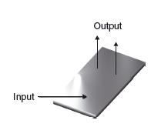
Plate Reverb
Distinct reflections are notably absent
Smooth noise like response
Physical properties of plate
Density, ρ
Young’s Modulus, E
Poisson’s ratio, ν
Geometrical properties
Thickness, H
Surface area, A

Slide 45


Equation of Motion : Plate
Equation of motion (thin lossless plate)
Dispersion relation
Wave velocity
Stiffness parameter

Slide 46
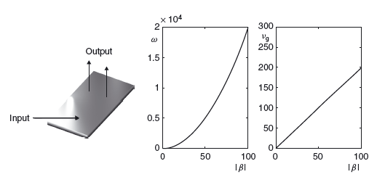
Plate Reverb
Dispersive wave propagation
Dispersion relation
Group velocity

Slide 47
Plate Displacement
High frequency components travel faster than low frequency components
Loses coherence as it travels
Roughly constant mode density for plates as compared to room (increases as f²)
Computation
K = 0.737, A =2, N ~ 8.29 E4

Slide 49

Case Study : Plate Reverb
Distributed modeling technique
Time domain numerical simulation
Finite difference schemes
Based on direct solution to the equation of motion
Equation of free vibration
Lossless thin plate
Externally driven plate
σ ≥ 0 : loss parameter

Slide 50
Numerical Example : Plate
f(t) : force signal in N (known)
x_{i}, y_{i} : location of application
δ : Dirac delta function
Numerical parameters selection
Sampling rate (f_{s}) , time step, T = 1/f_{s}
Spatial grid to numerically solve PDE
Rectangular grid, x ε [0,L_{x}], y ε [0,L_{y}], spacing X
Irregular grids

Slide 51



Algorithm : Plate
u_{l,m}^{n} : approximate solution, u(x,y,t)
t = nT, x = lX, y = mX
Appropriate boundary conditions
Explicitly operates over three time steps

Slide 52
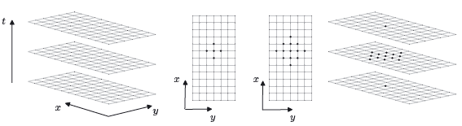
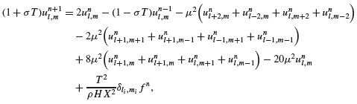
Algorithm : Plate

Slide 53
Algorithm : Plate
Vector – matrix form
u^{n} : column vector “stacked” over the grid
B, C : matrices consolidating effect of loss and spatial difference
r : column vector choosing input location

Slide 54
Reverb 2x1
Reverb 1x1
Reverb 1x1, Rho=10,000

Slide 55
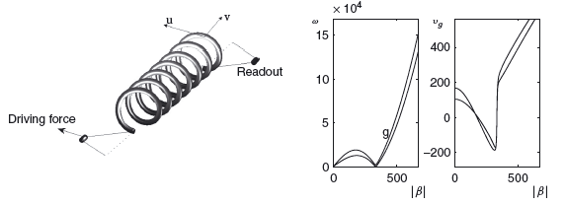
Spring Reverb
Helical spring under low tension
Driven through an EM coupling
Readout via a pickup
Coupling of transverse, longitudinal motion
Coherent wave propagation (leading to echoes)
Highly dispersive propagation (resembling room and plate reverb)

Slide 56
Spring Reverb
“Hump” in the low wavenumber range
Cutoff (2 - 5 kHz)
Low dispersion and strong echoes at low wavenumbers
As wavenumber nears cutoff, group velocity decreases and frequency components of echoes are distorted increasingly (slowed)
Above cutoff, faster group velocity leads to distorted echoes recurring at a higher rate (similar to transverse motion for a straight bar)

Slide 57
Thank You
Questions?

